Slide 1
Design Pattern in java

Slide 2
Design patterns represent the best practices used by experienced object-oriented software developers.
Design patterns are typical solutions to commonly occurring problems in software design.
They are like pre-made blueprints that you can customize to solve a recurring design problem in your code.
Design patterns are solutions to general problems that software developers faced during software development.
These solutions were obtained by trial and error by numerous software developers over quite a substantial period of time.

Slide 3
What is Gang of Four (GOF)?
Design Patterns - Elements of Reusable Object-Oriented Software which initiated the concept of Design Pattern in Software development.

Slide 4
Types of Design Patterns
Design Patterns - Elements of Reusable Object-Oriented Software
1.Creational Patterns These design patterns provide a way to create objects while hiding the creation logic, rather than instantiating objects directly using new operator. This gives program more flexibility in deciding which objects need to be created for a given use case.
2.Structural Patterns These design patterns concern class and object composition. Concept of inheritance is used to compose interfaces and define ways to compose objects to obtain new functionalities.
3.Behavioral Patterns These design patterns are specifically concerned with communication between objects.
4.J2EE Patterns These design patterns are specifically concerned with the presentation tier. These patterns are identified by Sun Java Center.

Slide 5
Creational Design Pattern
Singleton Design Pattern
Factory Design pattern

Slide 6
SingleTon Design Pattern
The singleton pattern is a design pattern that restricts the instantiation of a class to one object.

Slide 7
Singleton Design Pattern
Singleton
Create a singleton class
Test Singleton class
Eager Initialization
Handle Multiple Threads
Improve Multi Threading Logic
Serialization and Singleton
Handle De-Serialization
Override the clone method
The Reflection Problem
Enum Solution

Slide 8
Factory method design pattern in Java
It is a creational design pattern which talks about the creation of an object.
The factory design pattern says that define an interface ( A java interface or an abstract class) and let the subclasses decide which object to instantiate.
The factory method in the interface lets a class defer the instantiation to one or more concrete subclasses.
Since this design patterns talk about instantiation of an object and so it comes under the category of creational design pattern.
If we notice the name Factory method, that means there is a method which is a factory, and in general factories are involved with creational stuff and here with this an object is being created.
It is one of the best ways to create an object where object creation logic is hidden to the client.

Slide 9
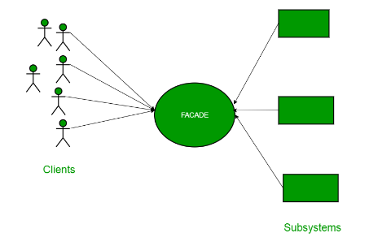
Structural design patterns. Facade Pattern
https://www.geeksforgeeks.org/facade-design-pattern-introduction/

Slide 10
Observer design Pattern

